Slide 1
Computational Dolly Zoom
Beatrice Hoang and Jessica Wan

Slide 2
Goals
Dolly Zoom → Significant Skill
Goal:
Computationally reproduce dolly zoom effect using 1 image
Paper:
Liang et al. (2020). The “Vertigo Effect” on Your Smartphone: Dolly Zoom via Single Shot View Synthesis
Notes:
Hello! Our project aims to achieve the dolly zoom effect, popularized by the movie Vertigo. The dolly zoom effect is created by a cameraman simultaneously moving away from the subject while zooming in on the lens, creating a dizzying effect as the background seems to grow nearer without the subject moving. We wanted to explore how to achieve this effect computationally with Liang et al’s paper, which only uses one input image to output varying levels of dolly zooms.

Slide 3
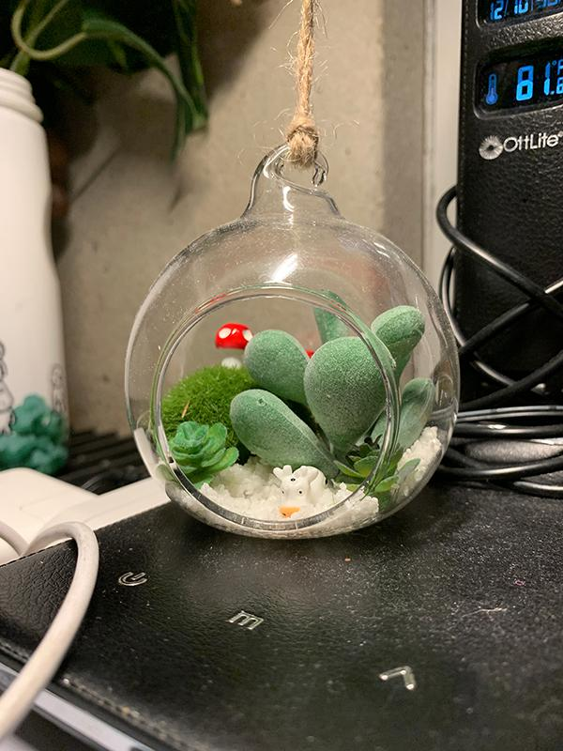
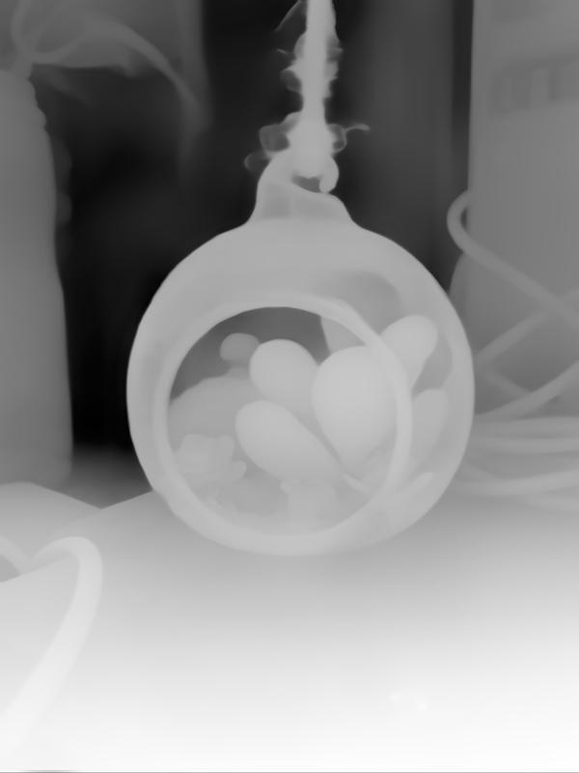
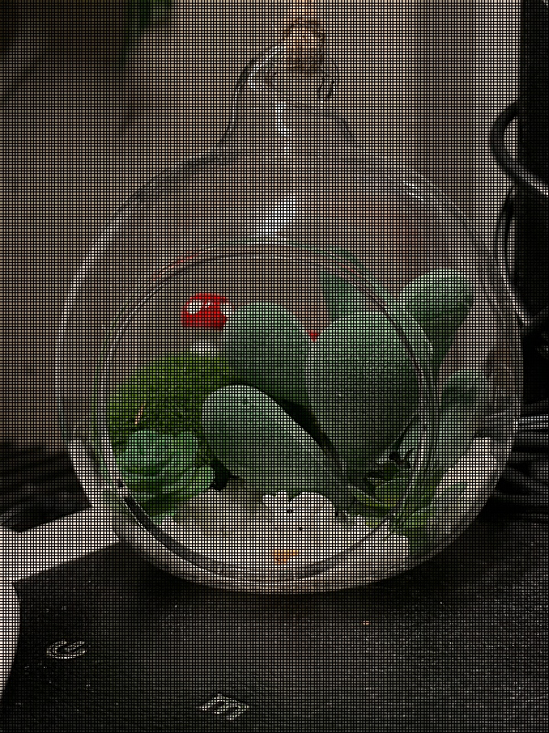
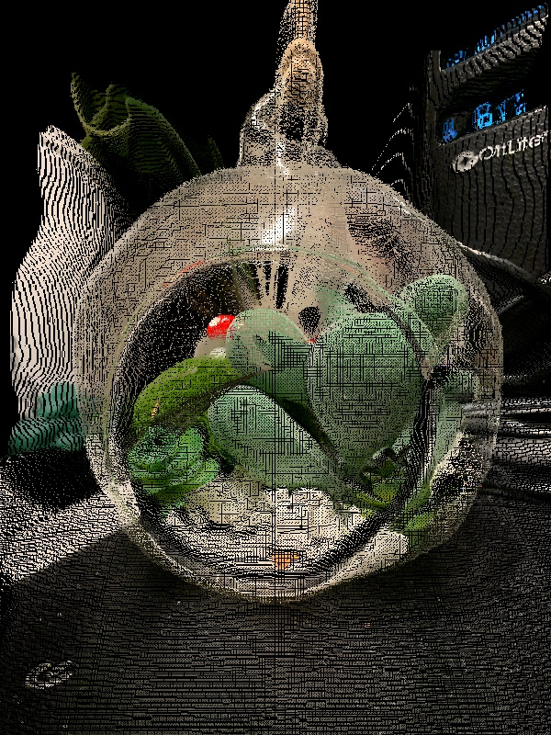
Pipeline
1. Input: Original Image, known focal length
2. ZoeDepth model → depth map
3. Digitally zoom image and depth map
4. Apply artificial dolly zoom x 2 “zoom levels”
5. Fuse outputs together
6. Fill gaps and holes

Slide 4
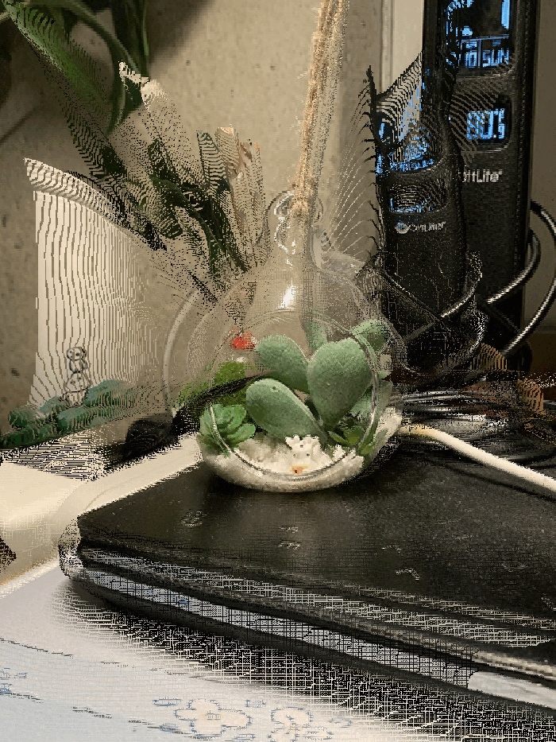
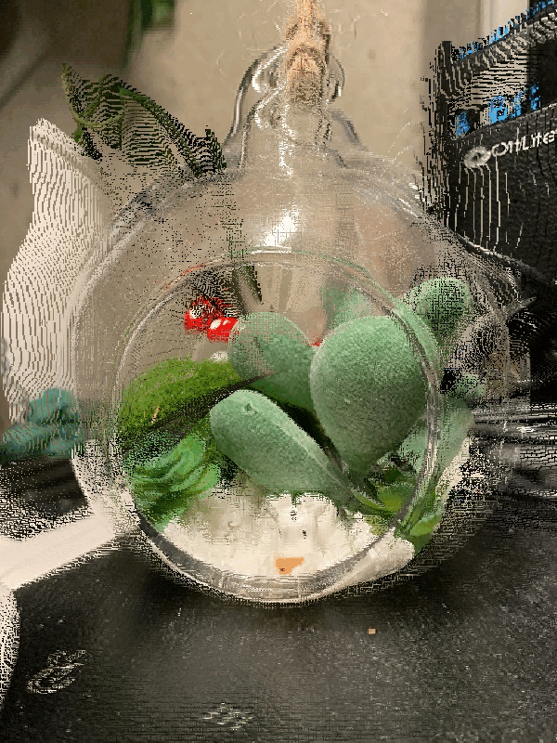
Results: Cow - hole filling source: orig zoomed img

Slide 5
Results: Cube - hole filling source: fused image

Slide 6
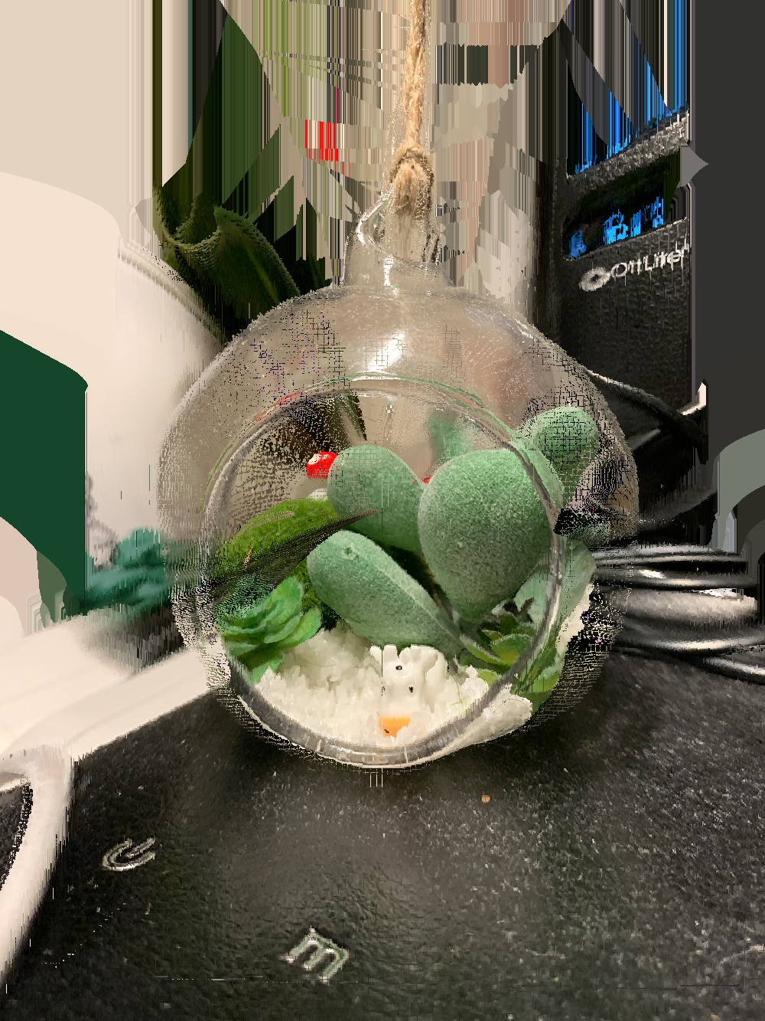
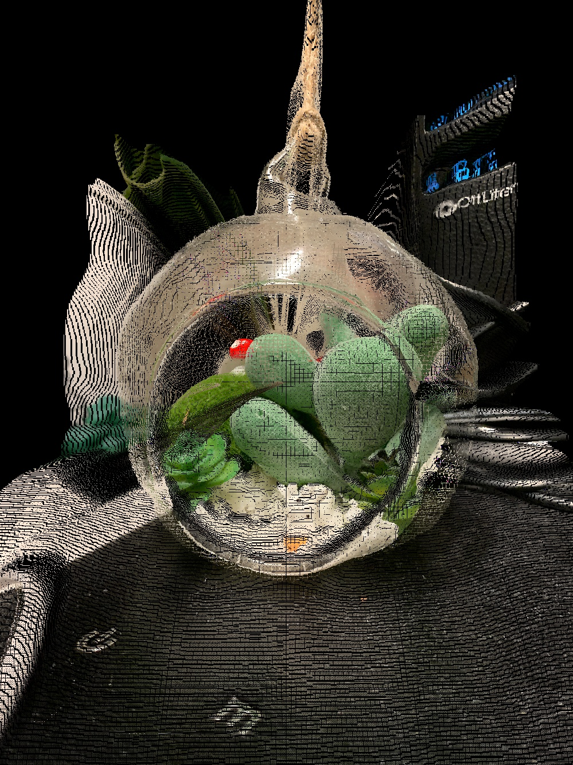
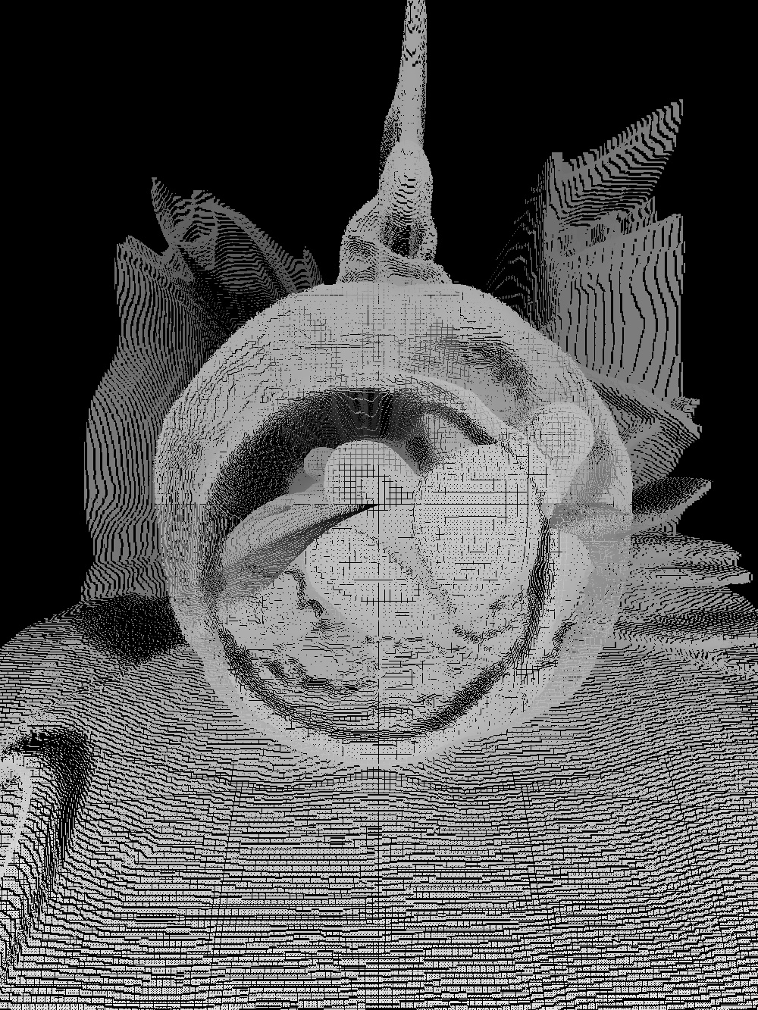
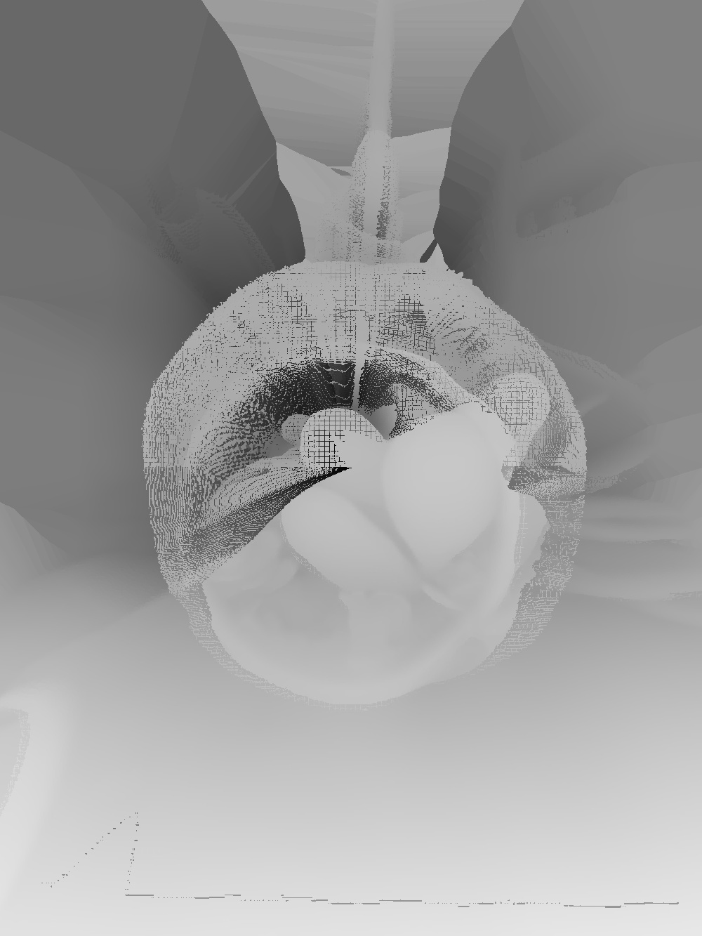
Key Problems: holes
Artificial DZ warps too much → harder to fill holes
currently: using a nearest neighbors solution

Slide 7
Next Steps
tune parameters, different interpolation
Shallow DoF

